Slide 1

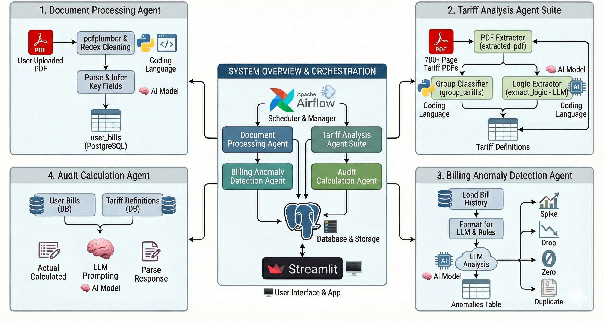
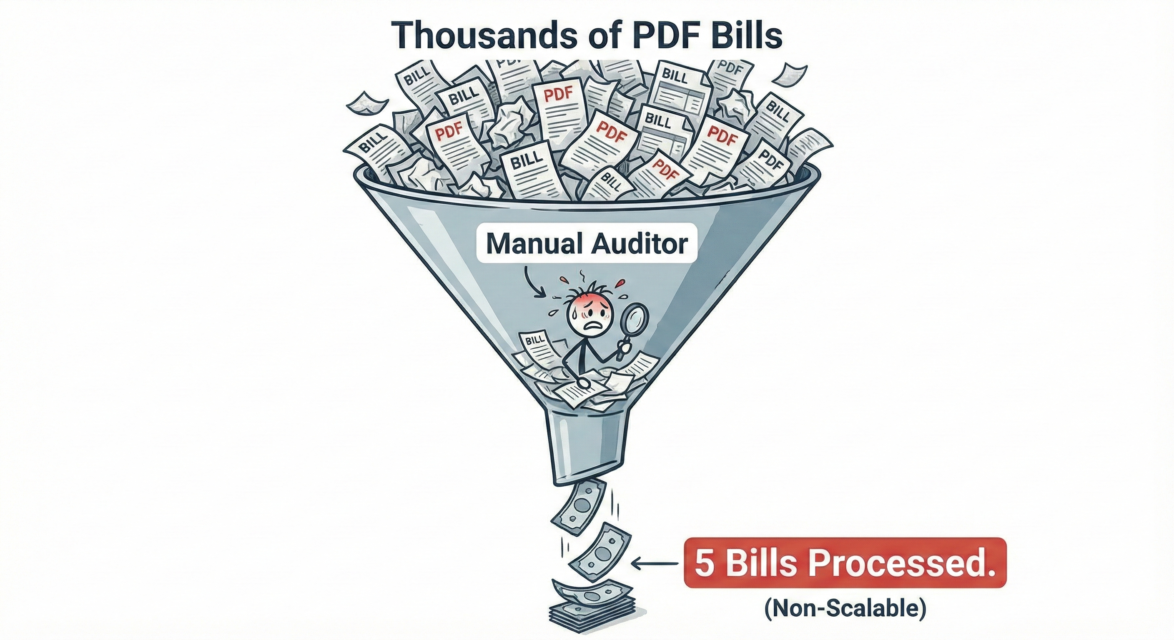
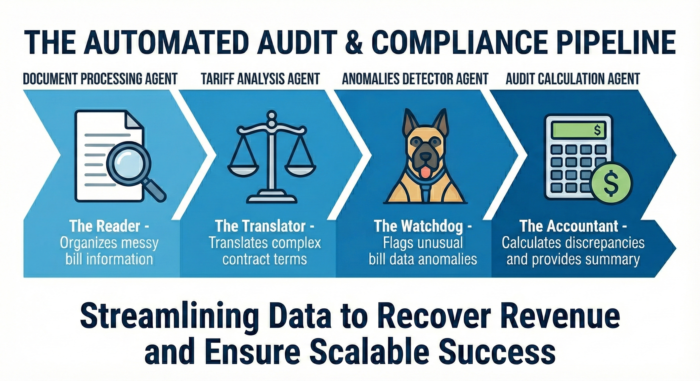
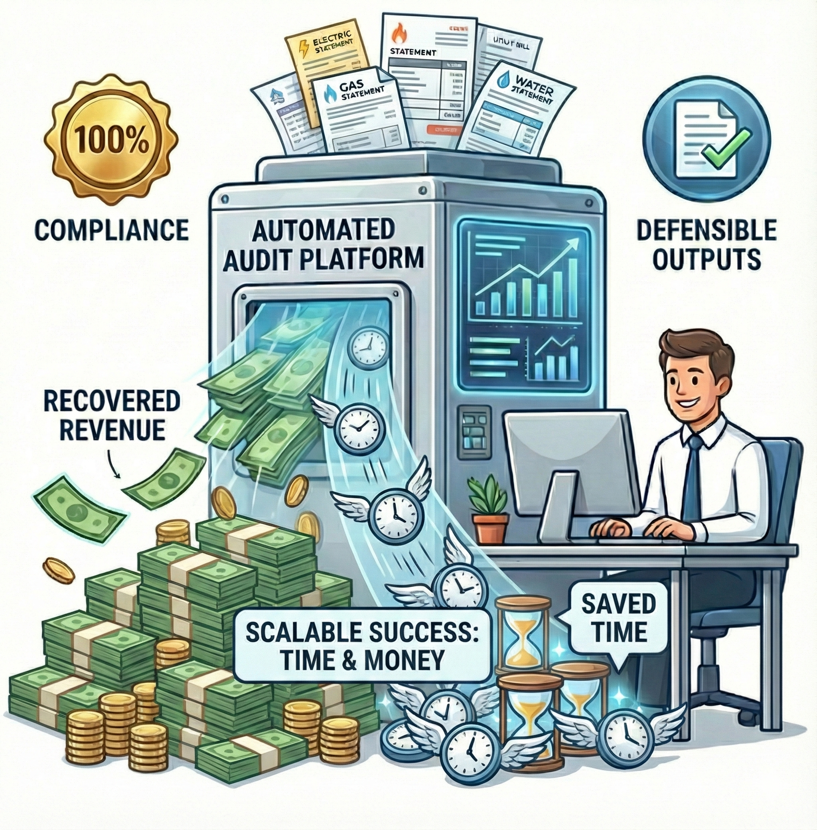
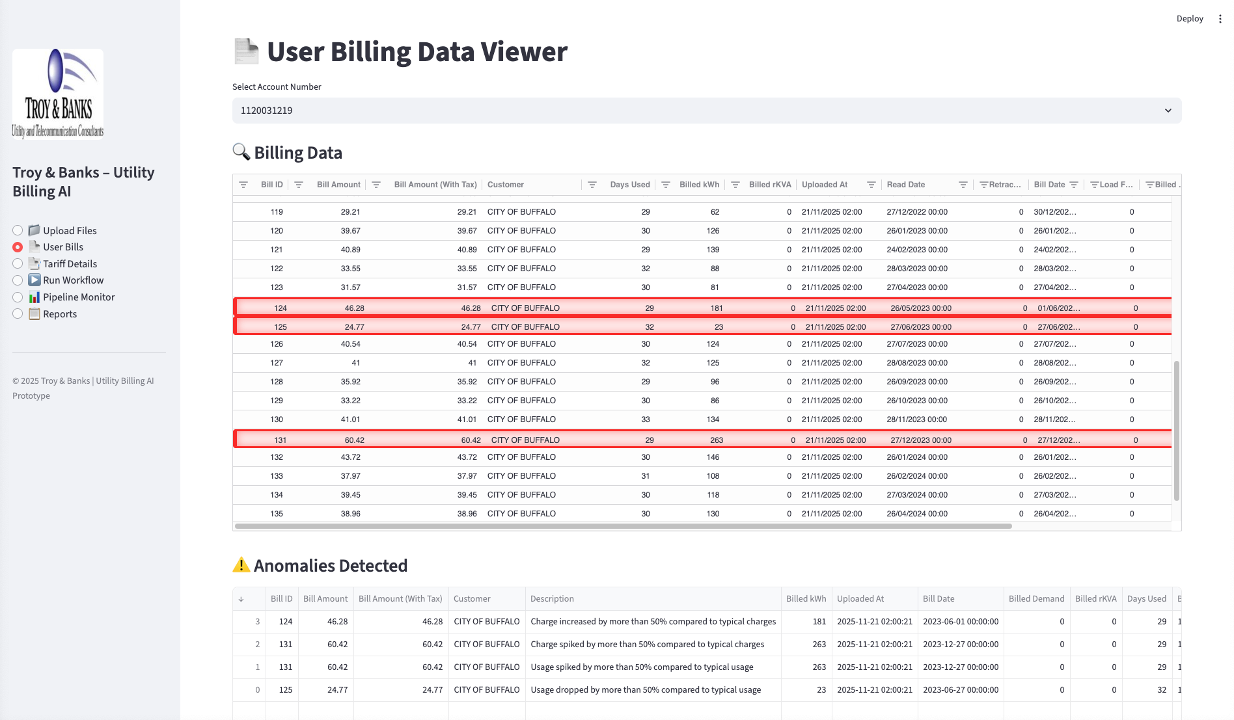
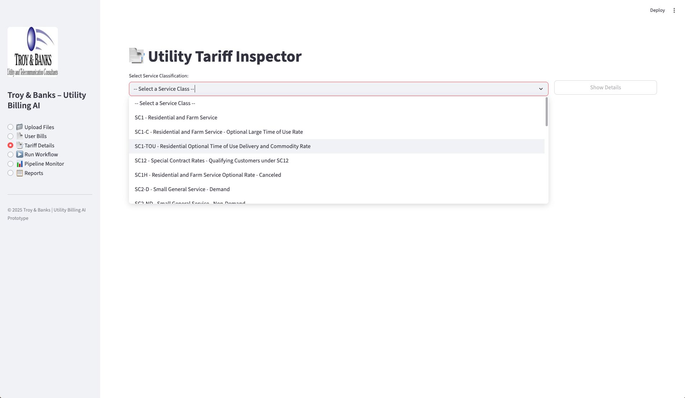
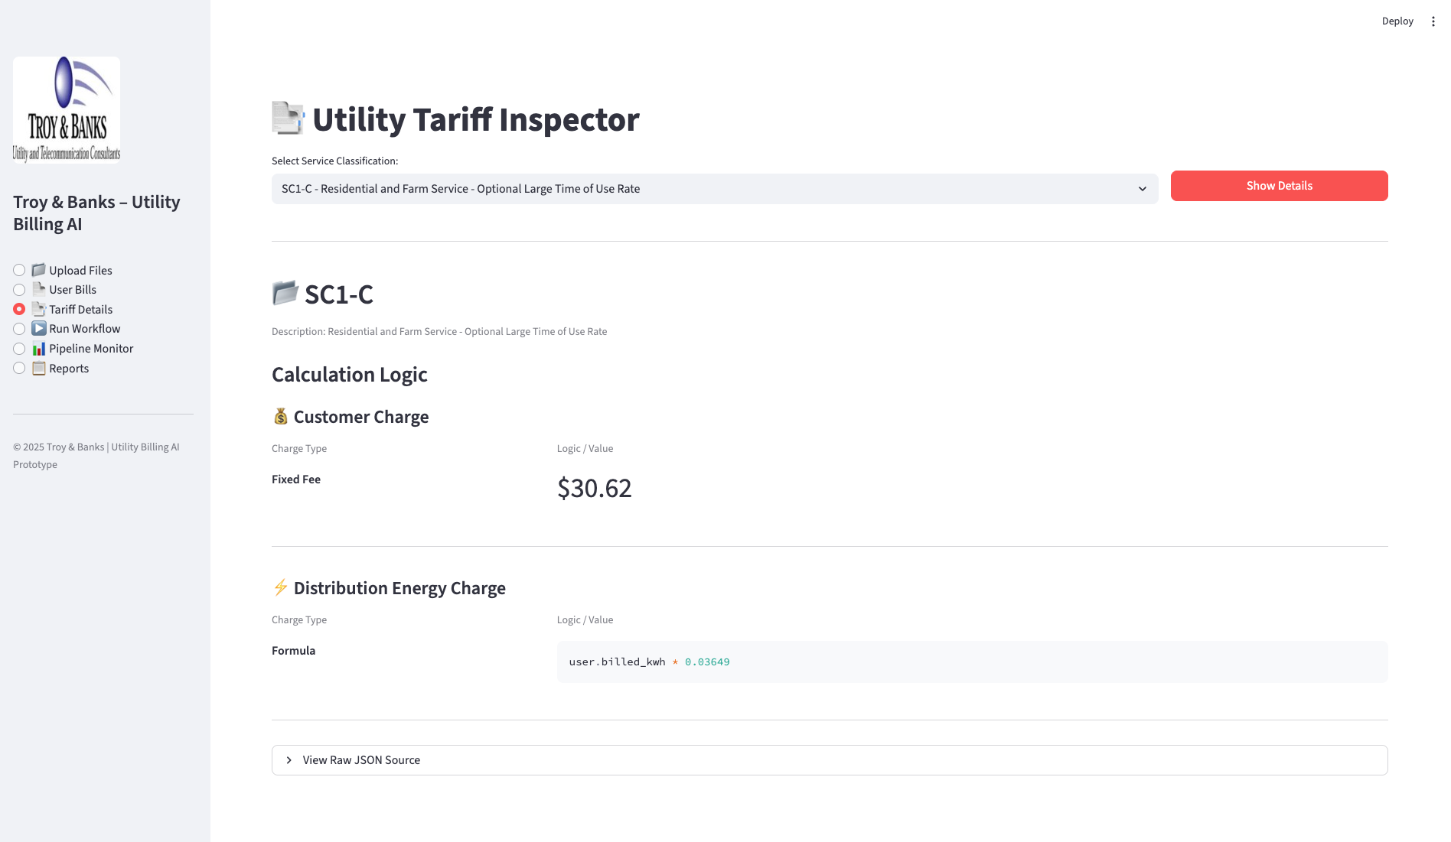
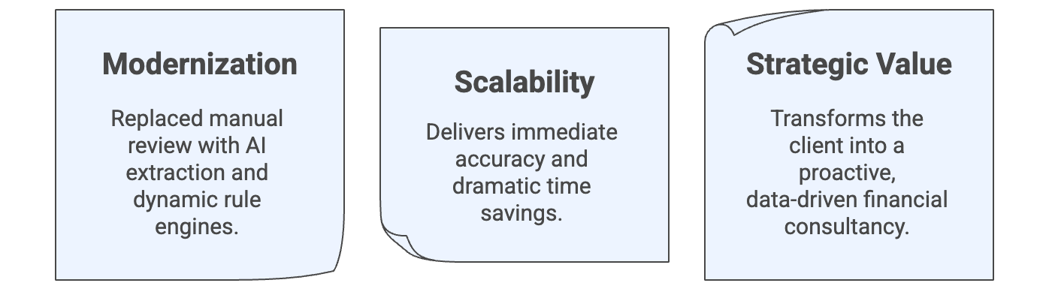











AI-Driven Utility Billing Automation:
Scalable Auditing with Dynamic Tariff Engines
Transforming Manual Energy Auditing with Multi-Agent Systems and LLMs
Team : EagleEye
Harshal Patil, Avipsa Bhujabal, Aarushi Jugran
Acknowledgements:
Kevin Gibbs, Vice President of Strategic Partnerships; Troy & Banks, Inc.
Justin Raybeck, Energy Auditor/Advisor ; Troy & Banks, Inc.
THE CHALLENGE :
SYSTEM ARCHITECTURE:
Utility auditing is a highly specialized, labor-intensive process that resists traditional automation due to data complexity.
Unscalable Workflow: Human experts require 2-4 hours to process a single complex municipal bill.
Capacity Cap: Operational limits restrict output to just 5-10 bills per day per auditor.
Data Heterogeneity:
Bills: Thousands of formats across different utility providers and service classes.
Tariffs: Pricing rules are buried in 700+ page PDF legal documents, making simple "regex" extraction impossible.
The Manual Bottleneck :
Our Agentic Pipeline:
Scalable Business Value :
DASHBOARD :
Smart Billing Audit & Visualization
Universal Tariff Explorer
Instant Tariff Logic
Impact Summary:
Voice of Our Client:
TECH STACK :
. . . . .
Institute for Artificial Intelligence and Data Science
School of Engineering and Applied Science
Mentors: :
Prof. Adithya Narayanan,
Prof. Saverio Marrazzo

